Slide 1

Title: Consumer Goods Ad-hoc Insights Using SQL Subtitle: Code basics Challenge 4
Name: Sristu Sai Priya
Date:3/20/2026

Slide 2

BUSINESS CONTEXT:
This presentation delivers a concise, executive-ready analysis of consumer goods performance.
Analysis is based on ad-hoc SQL queries applied to the dataset.
Covers:
Dataset structure and tables
Ten analytical queries with visuals
Key insights and actionable recommendations
Purpose: Drive growth and improve margins through informed business decisions.

Slide 3
Title : Objective
Deliver actionable insights on consumer goods performance.
Highlight key trends in products, segments, and sales channels.
Identify top customers and high/ low-cost products.
Support strategic decisions for growth and margin improvement.

Slide 4
Dataset Overview:
dim _ customer: contains customer-related data.
Dim _ product: contains product-related data.
Fact _ gross _ price: contains gross price information for each product.
Fact _ manufacturing _ cost: contains the cost incurred in the production of each product.
Fact _pre_ invoice_ deductions: contains pre-invoice deductions information for each product.
Fact _sales_ monthly: contains monthly sales data for each product.

Slide 5
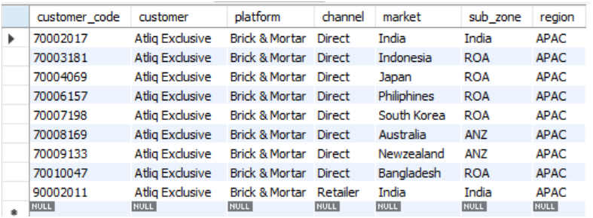
Query-1: Provide the list of markets in which customer “ATLIQ- Exclusive” operates its business in the APAC region.
Insights:
ATLIQ Exclusive operates across multiple markets in the APAC region, indicating a strong regional presence and expansion strategy.

Slide 6
Query-2:
What is the percentage of unique product increase in 2021 vs. 2020? The final output contains these fields, unique_products_2020 unique_products_2021 percentage _Chg.
Insights:
The company achieved a 36.33% increase in unique products from 2020 to 2021, indicating strong product expansion and potential for higher market reach.

Slide 7
Query-3:
Provide a report with all the unique product counts for each segment and sort them in descending order of product counts. The final output contains 2 fields, segment product _ count .
Insights:
The Network segment leads with the highest product count (129), followed by Accessories and Peripherals, indicating a strong focus on connectivity-related products.

Slide 8
Query-4:
Which segment had the most increase in unique products in 2021 vs 2020? The final output contains these fields, segment product_count_2020 product_count_2021 difference .
Insights:
The Accessories segment recorded the highest growth, increasing by 34 products from 2020 to 2021, indicating strong demand and strategic expansion in this category.

Slide 9
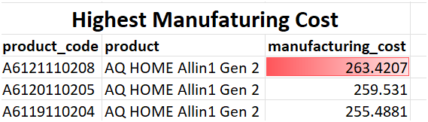
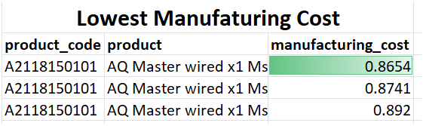
Query- 5:
Get the products that have the highest and lowest manufacturing costs. The final output should contain these fields, product _ code, product, manufacturing _ cost.
Insights:
The manufacturing cost ranges from 0.8654 to 263.4207, showing a significant variation across Products.
High-cost products may impact profitability, while low-cost products offer better margin Opportunities.
This analysis supports pricing strategies and cost optimization decisions.

Slide 10
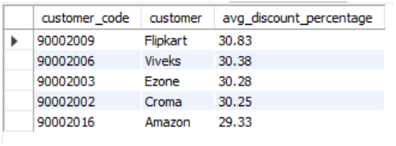
Query-6:
Generate a report which contains the top 5 customers who received an average high pre _ invoice _ discount_ pct for the fiscal year 2021 and in the Indian market. The final output contains these fields, customer _ code, customer ,average _ discount _ percentage.
Insights:
The top customers in India receive higher average discounts, indicating a strategy focused on customer retention and high-volume sales.

Slide 11
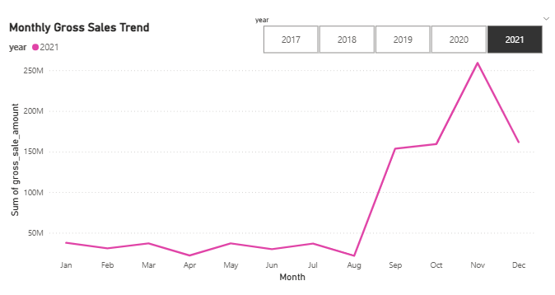
Query-7:
Get the complete report of the Gross sales amount for the customer “ATLIQ-Exclusive” for each month . This analysis helps to get an idea of low and high-performing months and take strategic decisions. The final report contains these columns: Month, Year ,Gross sales Amount .
Insights:
In every year, including 2021, November has the highest sales among all Months.
Sales increase throughout the year and reach their peak in November, with 2021 showing the highest overall sales.

Slide 12
Query-8:
In which quarter of 2020, got the maximum total _ sold_ quantity? The final output contains these fields sorted by the total _ sold _ quantity, Quarter total _ sold _ quantity .
Insights:
Q1 recorded the highest sales in 2020, indicating a peak in demand during this period.

Slide 13
Query-9:
Which channel helped to bring more gross sales in the fiscal year 2021 and the percentage of contribution? The final output contains these fields, channel gross _sales _ mln percentage.
Insights:
The Retailer channel contributes the highest share of gross sales, making it a key driver of overall revenue.

Slide 14
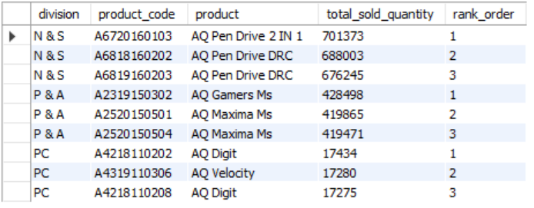
Query-10:
Get the Top 3 products in each division that have a high total _ sold _ quantity in the fiscal _ year 2021?
The final output contains these fields, division, product _ code,
Product , total _ sold _ quantity , rank _ order.
Insights:
Top-performing products vary across divisions, emphasizing the importance of targeted product and marketing strategies.

Slide 15
Key Insights:
The product portfolio expanded significantly with a 36% increase in unique products in 2021.
The Network segment has the highest product concentration, indicating core business focus.
The Accessories segment is the fastest-growing, showing strong demand and expansion potential.
Top customers receive higher discounts, highlighting a focus on retention and high-volume sales.
Sales show clear seasonal trends, with certain quarters driving higher Demand.
Revenue is largely driven by key sales channels, indicating dependency on specific channels.

Slide 16
RECOMMENDATIONS :
Focus on high-growth segments like Accessories to maximize future revenue.
Optimize discount strategies to balance customer retention and profit margins.
Invest more in top-performing sales channels to drive revenue growth.
Plan inventory and operations based on seasonal demand Patterns.
Promote and prioritize top-performing products in each division.

Slide 17
CONCLUSION:
This project demonstrates how data-driven insights can support strategic decisions, drive growth, and improve profitability in the consumer goods industry.

Slide 18


